Slide 1
Analysis of the Olympic for athletics
SportsStats
Fabian Enrique Pedreros
September 2022
Data from 1896 to 2016

Slide 2
Build on project proposal
Client 3: SportsStats (Olympics Dataset - 120 years of data)
The client/dataset selected was SportStats with the Olympics dataset, I chose it because one of the applications of data science is the business of sports, and I want to discover information about the performance of athletics in the Olympics, and establish if is possible to determine the demographic variables capable to predict a medal winner.

Slide 3
Build on project proposal
Questions
Does an athlete have a greater or lesser chance of winning a medal at the Olympics if she is a woman?
Do young athletes (under 20 years old) have a greater chance of winning a medal in athletics than athletes over 20 years old?
Does the height and weight of the athletes influence the chances of winning a medal?

Slide 4
Build on project proposal
Hypothesis
I believe that women have a greater chance of winning a medal in athletic competitions at the Olympics, given that there are fewer women than men who enter.
My instinct leads me to think that if there is a relationship between age, height, weight and medal winning.
Athletes under the age of 20 should be in better physical condition and therefore should win the most medals.

Slide 5
Build on project proposal
Approach
The attributes to be used will be:
age
sex
weight
Height
Medal
Sport
A new attribute is required to be created which is Medal_winner, which will specify whether an athlete won medal (1) or not (0), as well as the attribute 'under 21'.
SQL will be used to query the required information and through data visualization to determine if there are differences between populations. The measures to be taken into account will be the proportions of medal winners, for the categorical attributes, and for the numerical will be the observed behavior of the distributions and box plots.

Slide 6
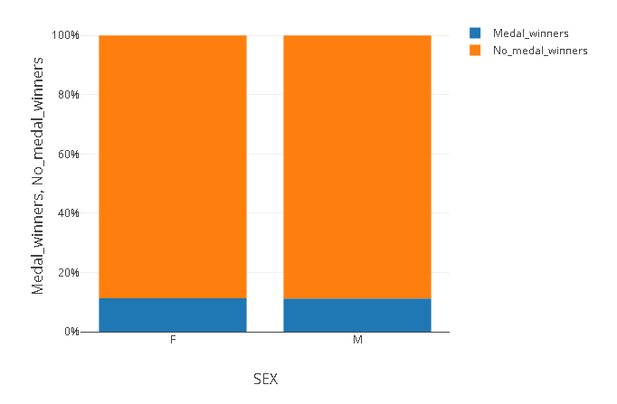
Insights Discovered
Does an athlete have a greater or lesser chance of winning a medal at the Olympics if she is a woman?
11.2% of the athletes win a medal
Winners by gender are similar, no matter if the athlete is a woman or a man, all have the same probability according to the number of participants and the winning rate.

Slide 7
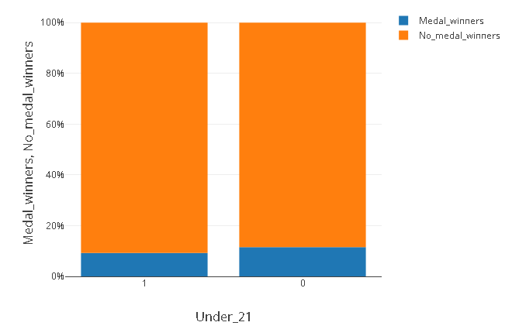
Insights Discovered
Do young athletes (under 20 years old) have a greater chance of winning a medal in athletics than athletes over 20 years old?
Athletes over 20 years old have 2.17% more medals won than younger athletes
The fact of being a young athlete does not increase the probability of winning a medal, but on the contrary decreases it.
Needs a further exploration

Slide 8
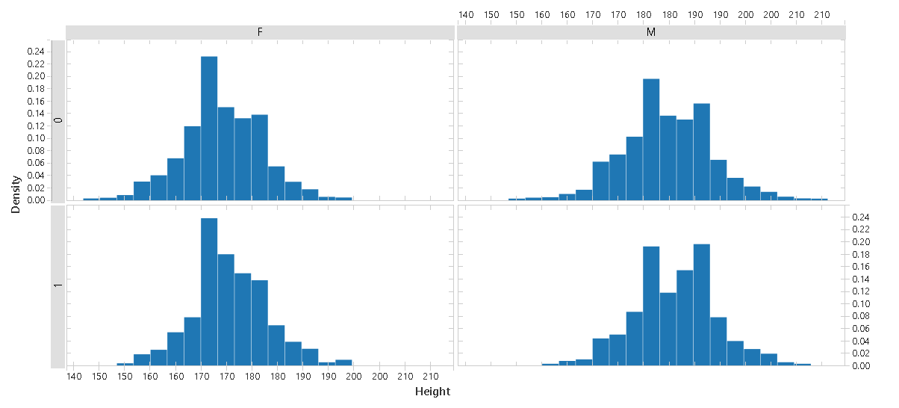
Insights Discovered
Does the height and weight of the athletes influence the chances of winning a medal?
There are differences in the height distributions between athletes who win a medal and those who do not (separated by sex), but there is not a large difference and a clear behavior that would lead to establish that greater height increases the probability of winning a medal.

Slide 9
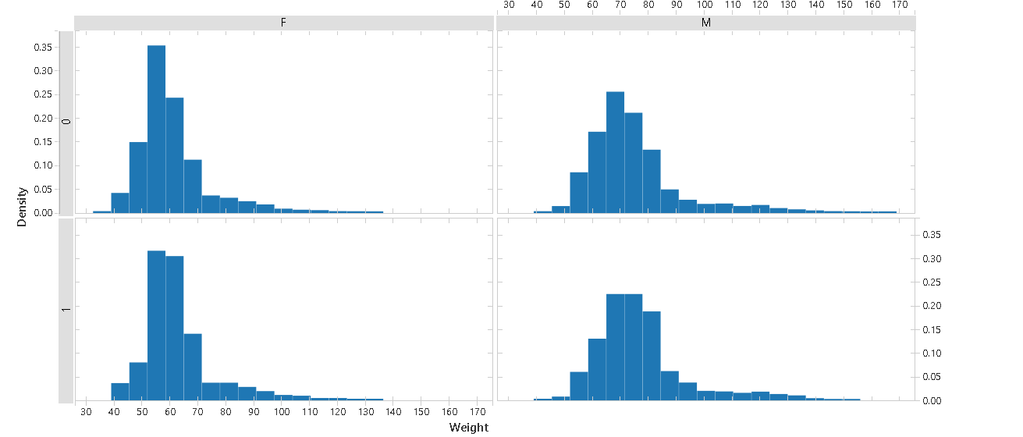
Insights Discovered
Does the height and weight of the athletes influence the chances of winning a medal?
There are differences in the weight distributions between athletes who win a medal and those who do not (separated by sex), but there is not a large difference and a clear behavior that would lead to establish that greater height increases the probability of winning a medal.

Slide 10
Hypothesis
I believe that women have a greater chance of winning a medal in athletic competitions at the Olympics, given that there are fewer women than men who enter. Rejected hypothesis.
There are no significant differences between the proportions of athletes who have won medals according to sex, so women have the same probability as men of winning a medal.
My instinct leads me to think that if there is a relationship between height, weight and medal winning, Rejected hypothesis.
There is no clear tendency to associate the behavior of the height or weight of athletes with winning a medal.
athletes under the age of 20 should be in better physical condition and therefore should win the most medals. Rejected hypothesis.
There is no greater proportion of medal-winning athletes under 21 years of age, in fact the proportion of medal-winning older athletes is greater than that of younger athletes.

Slide 11
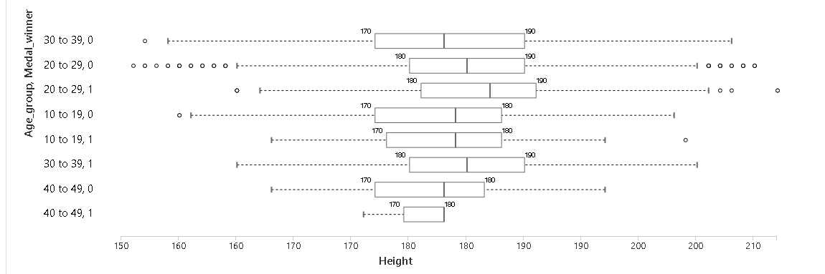
New variables creation
The categorical variable Age_group is created for the numerical variable age, so that it can be used to classify the athletes more globally than the age itself; this is one of the transformations normally used for data of this type.
The differences observed for both weight and height by sex, in terms of the central statistics, are not sufficient to validate that statistically there is a difference in age, weight and height that explains whether or not an athlete wins an Olympic medal.

Slide 12
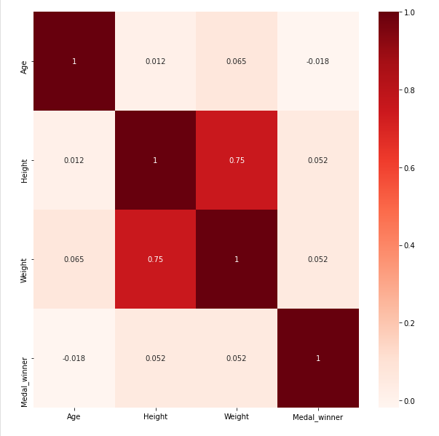
Additional questions
What is the correlation between the variables studied and winning a medal?
My hypothesis is that there will be an average positive correlation between weight and height with respect to winning or not winning a medal. And that age, when included in ten-year ranges, will show a negative correlation. Hypothesis rejected.
No Pearson correlation is observed that would indicate an associative behavior between winning a medal for athletes and other variables such as age, weight or height. Therefore, the hypothesis generated is rejected.

Slide 13
Conclusions
Statistically there is no correlation between winning a medal for athletes who practice athletics with age, weight, height and sex.
Therefore, it cannot be established whether or not an athlete with any specific behavior of these variables has a greater chance of winning a medal in the Olympics.
Recommendations and actions
In order to generate a model that can calculate the probability of winning a medal for athletes, other data is required, either demographic or specific to the performance of athletes in other competitions.

